Slide 1
CS 186 Exam Prep 9
Recovery

Slide 2
Recovery
WAL, Undo Logging, Redo Logging, ARIES
Notes:
The motivating problem is that production databases have lots of tables with increasingly complex relationships
ER diagrams help design and document these schemas

Slide 3
Recovery Policies
Steal/No Force
Steal - Uncommitted transactions can overwrite the most recent committed value of an object on disk
Necessitates UNDO for Atomicity (all or none of Xact’s operations persist)
No Force - Don’t have to write all pages modified by a transaction from the buffer cache to disk before committing the transaction
Necessitates REDO for Durability (not losing results of committed Xacts)
Harder to enforce atomicity and durability, but gives best performance
No Steal locks buffer pages from optimal use, but keeps uncommitted changes away from disk (easy atomicity)
Force necessitates extra writes on commit, but everything is guaranteed to be there (easy durability)

Slide 4
Write-Ahead Logging
Log records must be on disk before the data page gets written to disk.
How we achieve atomicity
Can’t undo an operation if data page written before log - don’t know operation happened
All log records must be written to disk when a transaction commits.
How we achieve durability
We know what operations to redo in case of crash

Slide 5
Undo Logging
Write log records to ensure atomicity after a system crash:
<START T>: transaction T has begun
<COMMIT T>: T has committed
<ABORT T>: T has aborted
<T,X,v>: T has updated element X, and its old value was v
If T commits, then FLUSH(X) must be written to disk before <COMMIT T>
Force – we can UNDO any modifications if a Xact crashes before COMMIT
If T modifies X, then <T,X,v> log entry must be written to disk before FLUSH(X)
Steal – we can UNDO any modifications if a Xact crashes before FLUSH

Slide 6
Recovery with Undo Log
Determine which txns are completed
Undo all modifications made by incomplete txns
Recovery manager must:
Read log from the end:
Actions to perform on records:
<T, X, v>: if T is not completed then write X=v to disk else ignore (T would have committed or aborted)
How far back in the log should we go?
All the way to the start (there could be a very long transaction)

Slide 7
Undo Log Example
Operation | t | Mem A | Mem B | Disk A | Disk B | UNDO Log
 |  |  |  |  |  | <START T>
READ(A, t) | 8 | 8 |  | 8 | 8
t := t*2 | 16 | 8 |  | 8 | 8
WRITE(A, t) | 16 | 16 |  | 8 | 8 | <T,A,8>
READ(B, t) | 8 | 16 | 8 | 8 | 8
t := t*2 | 16 | 16 | 8 | 8 | 8
WRITE(B, t) | 16 | 16 | 16 | 8 | 8 | <T,B,8>
FLUSH(A) | 16 | 16 | 16 | 16 | 8
FLUSH(B) | 16 | 16 | 16 | 16 | 16
COMMIT |  |  |  |  |  | <COMMIT T>

Slide 8
Redo Logging
Write log records to ensure durability after a system crash:
<START T>: transaction T has begun
<COMMIT T>: T has committed
<ABORT T>: T has aborted
<T,X,v>: T has updated element X, and its new value was v
If T modifies X, then both <T,X,v> and <COMMIT T> must be written to disk before FLUSH(X)
No-Steal, No-Force – we can REDO any modifications if a Xact crashes before FLUSH

Slide 9
Recovery with Redo Log
Determine which txns are completed
Redo all updates of committed transactions
Recovery manager must:
Read log from the beginning:
Actions to perform on records:
<T, X, v>: if T is committed then write X=v to disk else ignore (T either aborted or was not committed)

Slide 10
Redo Log Example
Operation | t | Mem A | Mem B | Disk A | Disk B | REDO Log
 |  |  |  |  |  | <START T>
READ(A, t) | 8 | 8 |  | 8 | 8
t := t*2 | 16 | 8 |  | 8 | 8
WRITE(A, t) | 16 | 16 |  | 8 | 8 | <T,A,16>
READ(B, t) | 8 | 16 | 8 | 8 | 8
t := t*2 | 16 | 16 | 8 | 8 | 8
WRITE(B, t) | 16 | 16 | 16 | 8 | 8 | <T,B,16>
COMMIT |  |  |  |  |  | <COMMIT T>
FLUSH(A) | 16 | 16 | 16 | 16 | 8
FLUSH(B) | 16 | 16 | 16 | 16 | 16

Slide 11
Undo/Redo Logging Summary
Undo logging:
Uses Steal/Force policies
Undoes all updates for running transactions
Redo logging:
Uses No Steal/No Force policies
Redoes all updates for committed transactions

Slide 12
Aries Recovery - LSNs
LSN (Log Sequence Number): stored in each log record. Unique, increasing, ordered identifier for each log record
flushedLSN: stored in memory, keeps track of the most recent log record written to disk
pageLSN: LSN of the last operation to update the page (in memory page may have a different pageLSN than the on disk page)
prevLSN: stored in each log record, the LSN of the previous record written by the current record’s transaction
lastLSN: stored in the Xact Table, the LSN of the most recent log record written by the transaction
recLSN: stored in the DPT, the log record that first dirtied the page since the last checkpoint
undoNextLSN: stored in CLR records, the LSN of the next operation we need to undo for the current record’s transaction

Slide 13
Recovery Structures
Transaction Table - stores information on active transactions. Fields include
Xid (Transaction ID)
Status (Running, Committing, Aborting)
lastLSN
Dirty Page Table (DPT) - tracks dirty pages (pages whose changes have not been flushed to disk)
pageID
recLSN

Slide 14
Record Types
Records have LSN, common fields include xid (transaction ID), pageID (for modified page), type
UPDATE - write operation (SQL insert/update/delete). Also includes fields for offset (where data change started), length (how much data was changed), old_data (old version of changed data - used for undos), new_data (updated version of data - used for redos)
COMMIT - Xact is beginning committing process (ARIES: flush log up to and including COMMIT record)
ABORT - Xact is beginning aborting process (ARIES: begin writing CLRs for undone UPDATEs)
Compensation Log Record (CLR) - indicates a given UPDATE has been undone
END - Xact is finished (as in, finished committing or aborting)

Slide 15
Record Types (cont.)
Checkpoint Records
Useful for ARIES analysis so we don’t start from very beginning of log
Checkpoint serves as snapshot of Xact Table/DPT
Fuzzy checkpoints - Xacts operating during checkpoint; Xact
BEGIN CHECKPOINT - checkpoint start, earliest point Xact Table/DPT could represent
END CHECKPOINT - checkpoint end, holds Xact Table/DPT snapshot
Master Record - stores location of most recent checkpoint for recovery purposes, usually LSN 0

Slide 16
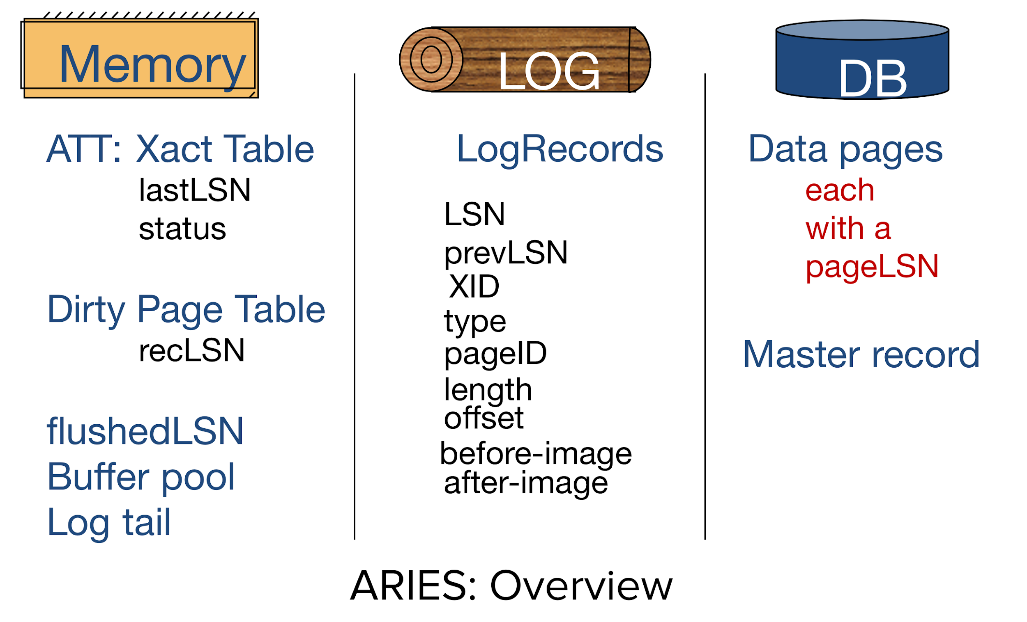

Slide 17
ARIES: Analysis (Part 1)
Reconstructing Xact Table and DPT
Need to know which transactions started/committed/aborted, which pages dirtied
Start from begin checkpoint log record (or start of log), go until end of log
On any record that is not an END record:
Add the Xact to the Xact Table if not in table
Set the lastLSN of the transaction to the current operation’s LSN
If the record is a COMMIT or an ABORT record, change the status of Xact to Committing/Aborting
If the record is an UPDATE record and the page being updated is not in the DPT, add the page to the DPT and set recLSN equal to the LSN
If the record is an END record, remove the transaction from the Xact table.

Slide 18
ARIES: Analysis (Part 2)
After going through the log, clean up the Xact Table
For each Xact in the Xact Table:
Write END records for committing Xacts. Because they’re committing, they must be finished - preserve durability
For running Xacts, change status to aborting and write ABORT record - preserve atomicity since not finished

Slide 19
ARIES: Redo
Redo updates and CLRs from the earliest recLSN in the DPT to get back unflushed changes from before crash, unless:
page not in DPT
page on disk must be up to date, since we have no changes!
recLSN of page > LSN
no need to undo here: recLSN of page is first record that dirtied page, so this change must have been flushed
pageLSN (disk) >= LSN
page LSN for disk (LSN of last record with change written to disk) is the authoritative source for determining which changes have been applied in disk
Redo with after-image (redo state), update pageLSNs as you go

Slide 20
ARIES: Undo
Undo each Xact in the Xact Table
Only UNDO updates (ignore CLRs)
Start at end of log and work backwards to the beginning
For every UPDATE the undo phase undoes, write a corresponding CLR to the log.
undoNextLSN stores the LSN of the next operation to be undone for that transaction (the prevLSN of the operation that you are undoing).
Once you have undone all the operations for a transaction, write the END record for that transaction to the log.

Slide 21
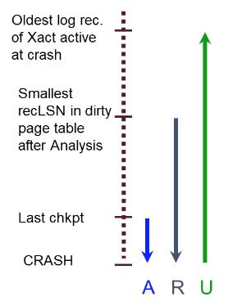
ARIES: Overall
Why does redo happen before undo?
If failure happens during redo or undo, next recovery can pick up what previous recovery has left and continue
E.g. Crash while writing CLRs in UNDO, we have to redo them
When are transactions removed from the xact table?
END log record
When is a page removed from the DPT?
When that page flushed to disk (pages aren’t necessarily flushed to disk on commit - no force)

Slide 22
ARIES Recovery Summary
1. Analysis
Goal: Rebuild the Xact Table and DPT at time of crash
Start at LSN after begin_checkpoint
If record != END
- Add xact to Xact Table if not there
- Set lastLSN of xact to record.LSN
If record = COMMIT or record = ABORT
- Change status in Xact Table accordingly
If record = UPDATE and record.page NOT IN DPT
- Add to DPT & Set recLSN to record.LSN in DPT
If record = END
- Remove xact from Xact Table
At the end:
If transaction is Committing
- Write END record and remove from Xact Table
If transaction is Running
- Write ABORT record and change status to Aborting
2. Redo
Goal: Maintain durability by getting back unflushed changes from before the crash
Redo everything from the earliest recLSN unless:
Page not in DPT
- Page on disk must be up to date, since we have no changes!
recLSN of page > LSN
- No need to redo here: recLSN of page is first record that dirtied page, so this change must have been flushed
On-Disk pageLSN >= LSN
- On-Disk Page LSN is the authoritative source for determining which changes have been applied already
3. Undo
Goal: Maintain atomicity by undoing any operations done by transactions running at the time of the crash
For all xacts in xact table not committing, change status to abort
Start from largest lastLSN in transaction table and work your way up the log.
- Write the relevant CLRs for any actions done by aborting transactions
For CLRs:
- prevLSN = lastLSN of associated transaction
- undoNextLSN = current record’s prevLSN
Performance optimization:
- Make a set containing the last undoNextLSN of each transaction (or lastLSN if no CLRs written for transaction yet)
- Undo the largest LSN, repeat

Slide 23
Worksheet

Slide 24
Conceptual Recovery

Slide 25
Question 1
Consider a scenario where we update the recLSN in the dirty page table to reflect each update to a page, regardless of when the page was brought into the buffer pool. What bugs might you see after recovery? Select all that apply. Explain your reasoning:
Some writes of committed transactions would be lost.
Some writes of aborted transactions would be visible in the database.
The system tries to commit or abort a transaction that is not in the transaction table.
Answer: a, b.
A is correct because during the REDO phase of recovery, some UPDATE log records that reflect writes that never made it to disk will be skipped.
Similarly, B is correct, because some CLR’s that reflect UNDO’s that never made it to disk will be skipped.
C is incorrect because even if REDO begins at a later LSN, the system does not add any new transactions to the transaction table during REDO.

Slide 26
Question 2
Suppose that you are forced to flush pages in the DPT to disk upon making a checkpoint. Which of the following cases are now guaranteed? There is one correct answer. Explain your reasoning.
We can skip one of the three phases (analysis/redo/undo) completely
We must start analysis from the beginning of the log
Redo will start at the checkpoint.
Redo must start from the beginning of the log
Undo can start at the checkpoint
Undo must run until the beginning of the log
Answer: c.
In general, we redo everything from the earliest recLSN in the DPT to get back unflushed changes from before crash. Since we can guarantee that all changes up to a checkpoint have been flushed, all unflushed changes from before the crash happened after the checkpoint. Therefore, we can redo starting from the checkpoint.

Slide 27
Question 3
If the buffer pool is large enough that uncommitted data is never forced to disk, is UNDO still necessary? How about REDO? Explain your reasoning.
Answer: UNDO isn’t necessary in terms of undoing operations on disk.
Having a buffer pool large enough to hold all uncommitted data means we don’t have to STEAL (allow an uncommitted transaction to overwrite the most recent committed value of an object on disk). Since all the updates will be sitting in the buffer pool at the time of crash, no changes will be made to disk, so no operations need to be undone. REDO is still necessary. REDO is needed to get back unflushed changes from before the crash. If everything is held in the buffer, this must be redone

Slide 28
Question 4
If updates are always forced to disk when a transaction commits, is UNDO still necessary? Will ARIES perform any REDOs? Explain your reasoning.
Answer: Only UNDO is necessary.
UNDO is necessary because we still have to finish aborting transactions that were in progress and weren’t committing. The updates that these transactions have gotten through so far must be rolled back. As for REDOs, ARIES might perform some redoes because there may be transactions still in progress at the time of a crash, but these will be undone in the UNDO phase.

Slide 29
Recovery Practice

Slide 30
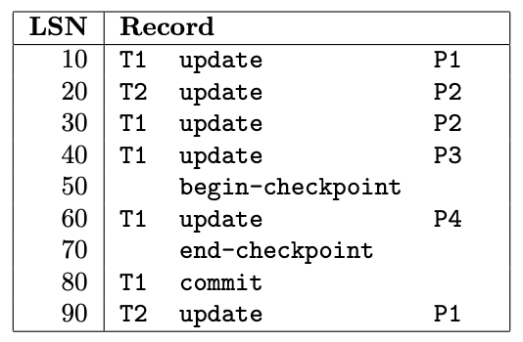
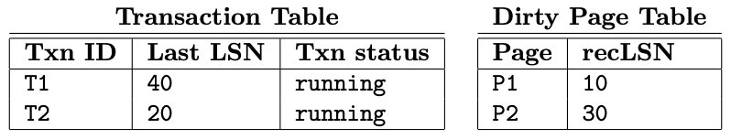
Question 1
What is the latest LSN that this checkpoint is guaranteed to be up-to-date to?
Answer: LSN 50 - the begin-checkpoint record.

Slide 31
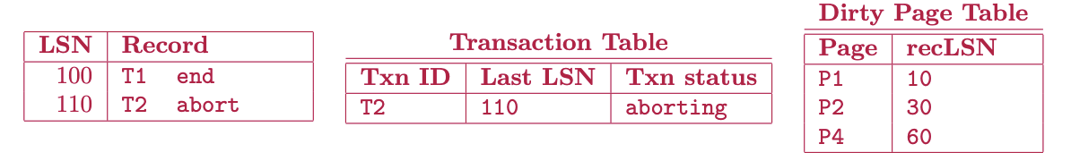
Question 2
What do the transaction table and dirty page table look like at the end of analysis, and what log records do we write during analysis?

Slide 32
Question 3
The next phase of ARIES is redo. What LSN do we start the redo from?
Answer: LSN 10 - the oldest recLSN in the Dirty Page Table

Slide 33
Question 4
From that record, we will redo the effects of all the following records, except we will not redo certain records. What are the LSNs of the records we do NOT redo?
Answer:
LSN 20 is not redone; the recLSN of P2 is already higher than 20, so the effects of LSN 20 are already on disk.
LSN 40 is not redone; page P3 is not in the dirty page table, and thus also already on disk.
LSNs 50, 70, 80, 100, and 110 are not update operations, so we don’t do anything for them.

Slide 34

Question 5
The last phase of ARIES is undo. What do we do for this phase? Answer this question by writing out the log records that will be recorded for each step. Stop after you write your first CLR record (make sure your CLR record specifies the nextLSN!).

Slide 35
Question 6
You load up the checkpoint. What does the transaction table and dirty page table look like?
Answer: Same as before, we never made another checkpoint!

Slide 36
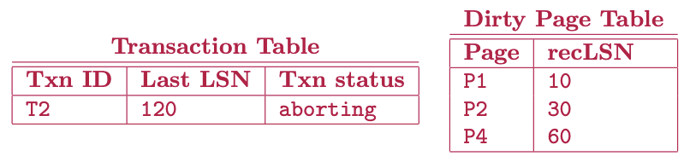
Question 7
You run the analysis phase. What do the transaction table and dirty page look like at the end of analysis?

Slide 37
Question 8
You run the redo phase. In order, what are the LSNs that we redo?
Answer: 10, 30, 60, 90, 120.
Importantly, note that we redid T1 even though it committed, and that we ARE redoing CLRs.

Slide 38
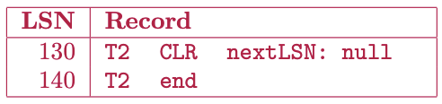
Question 9
Now we run the undo phase. What do we do? (Answer again with the log records that you have to add.)

Slide 39

Attendance Link
https://cs186berkeley.net/attendance

